Slide 1
Vehicle Dynamics and Simulation
Drivetrain Modelling
Dr Byron Mason

Slide 2
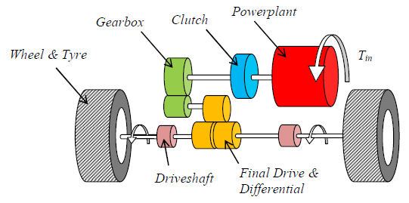
Drivetrain overview
Typical drivetrain
Drivetrain responsible for optimal delivery of torque.
High efficiency
Low NVH and driveability targets met.
Torque introduced at source i.e. powerplant and flows through drivetrain for delivery at tyre / road interface.
For our purposes a relatively simple model is required i.e. time to speed simulation and analysis
Drivetrain compliance and damping won’t significantly affect results.

Slide 3
Model development
Wheel and tyre
Model state 1 (3 dof)
Clutch, Transmission and Final Drive
J_{e}
J_{c1}
J_{c2}
J_{f}
Driveshaft
T_{e}
J_{w}
Engine, Flywheel and Clutch
J_{g}
J_{t}
Compliant connection (spring-damper)
Rigid connection
Friction interface

Slide 4
Model development
Wheel and tyre
Model state 2 (2 dof)
Clutch, Transmission and Final Drive
Engine, Flywheel and Clutch
Driveshaft
Compliant connection (spring-damper)
Rigid connection
Friction interface

Slide 5
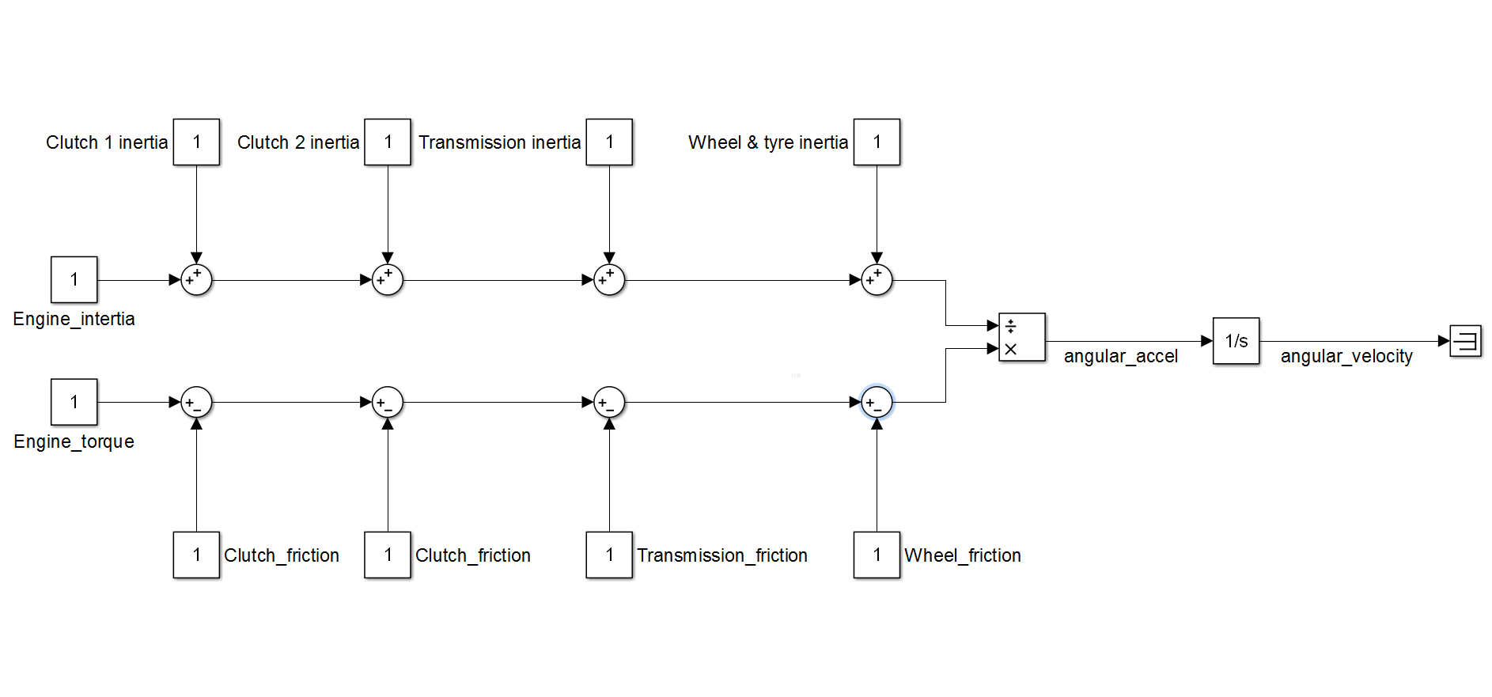
1-DOF

Slide 6
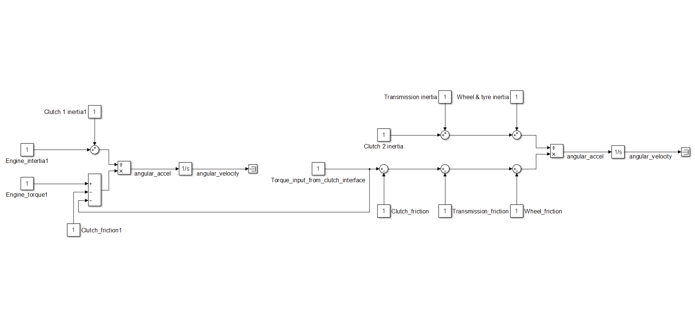
2-DOF
Some transition logic is required to add/remove extra DOF

Slide 7
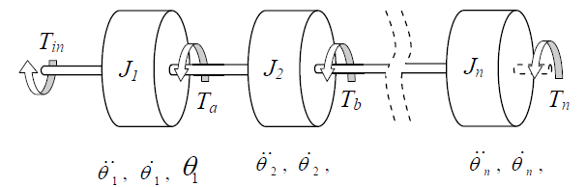
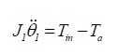
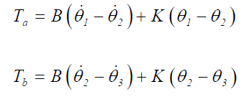
Model development

Slide 8
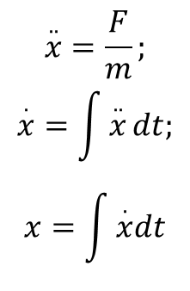
Single Inertia Vehicle Model
F_{t}
m
Good representation if F_{in} is available.
Simple to parameterise.
Good check for validity of more complex multi-dof models.
Disadvantages;
No clutch
Friction difficult to model
Unable to resolve any drivetrain performance details.
a
F_{in}
$$\overset{..}{x}=\frac{F}{m};$$
$$\overset{.}{x}=\int{\overset{..}{x}}dt;$$
$$x=\int{\overset{.}{x}dt}$$

Slide 9

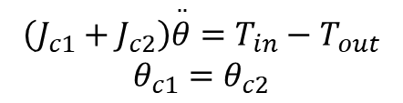
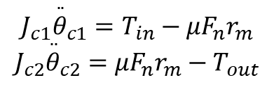

Engine, Flywheel and Clutch
Clutch is where the driveline splits and must be represented by some logic.
Simplest model just deals with transfer of torque.
More complex models include single or dual mass flywheels with non-linear clutch friction.
Non-linear effects
Lash
Spring constants
Unlocked clutch $ω_{rel}>0$ or $T_{in}>μF_{n}$ (2 DOF)
$$J_{c1}{\overset{..}{θ}}_{c1}=T_{in}−{μF}_{n}r_{m}$$
$$J_{c2}{\overset{..}{θ}}_{c2}={μF}_{n}r_{m}−T_{out}$$
Locked clutch $ω_{rel}=0$ or $T_{in}≤μF_{n}$ (2 DOF)
$$\left(J_{c1}+J_{c2}\right)\overset{..}{θ}=T_{in}−T_{out}$$
$$θ_{c1}=θ_{c2}$$

Slide 10
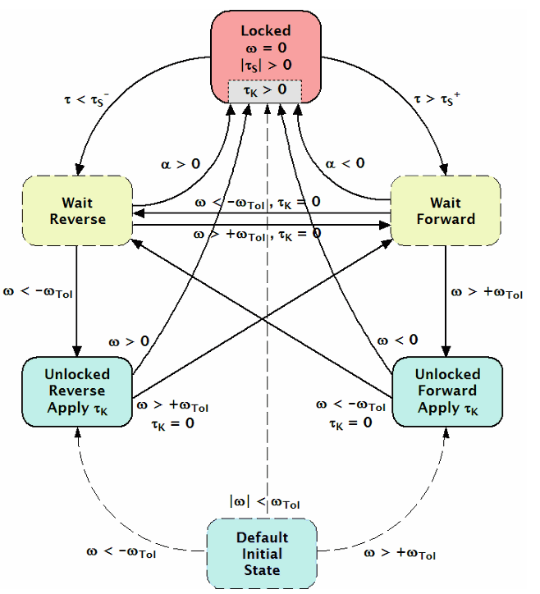
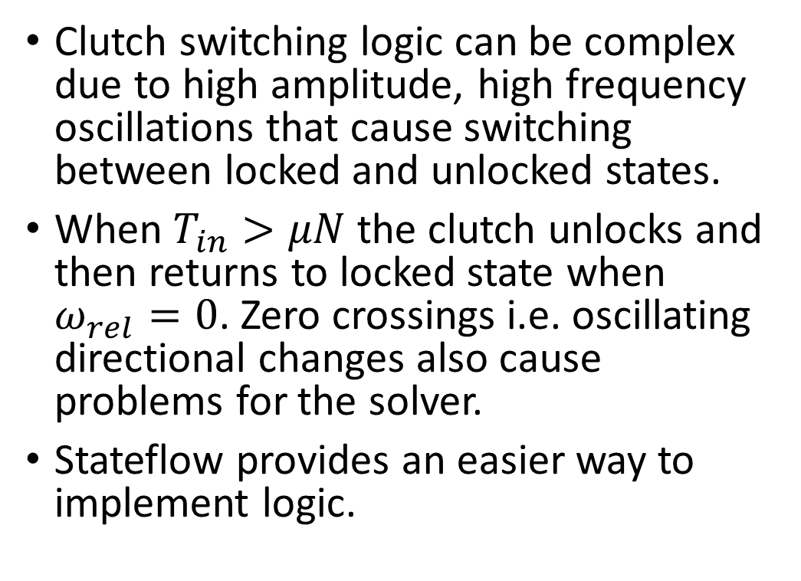
Engine, Flywheel and Clutch
Clutch state-diagram, typical logic
Clutch switching logic can be complex due to high amplitude, high frequency oscillations that cause switching between locked and unlocked states.
When $T_{in}>μN$ the clutch unlocks and then returns to locked state when $ω_{rel}=0$. Zero crossings i.e. oscillating directional changes also cause problems for the solver.
Stateflow provides an easier way to implement logic.

Slide 11
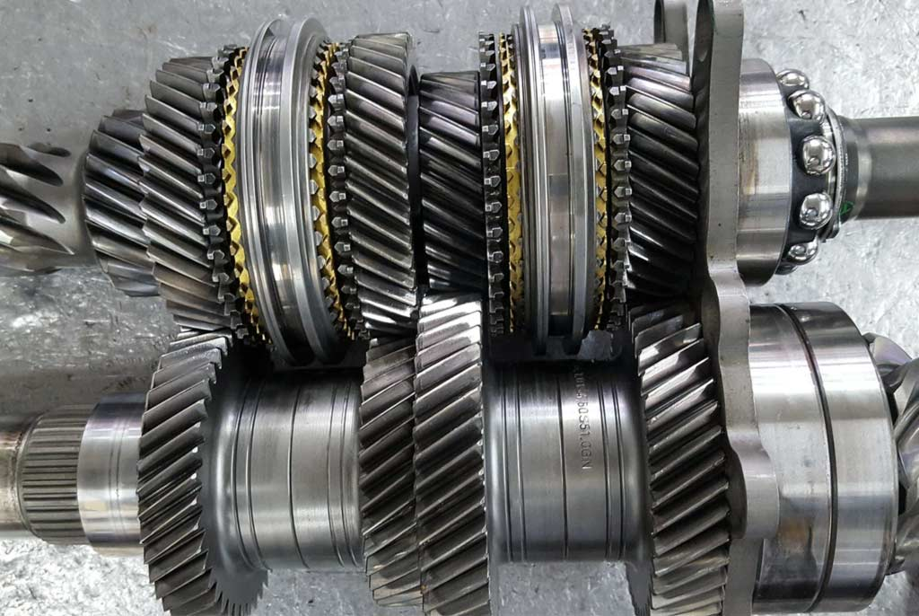
Transmission
Conceptually very simple however speed synchronisation of input and output shafts and inertia ‘switching’ i.e. 1dof -> 2dof -> 1dof adds complexity.
Lash non-linearity excites high frequency dynamics that result in very stiff system – can be dealt with by increasing damping.
Parameterisation can also be troublesome;
Different frictions and inertias depending on gear ratio.

Slide 12
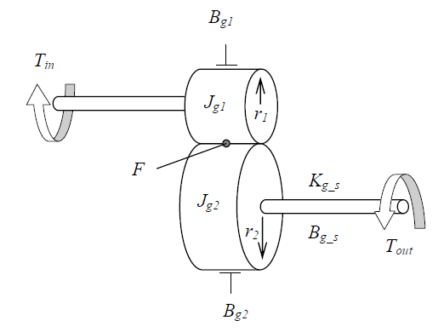
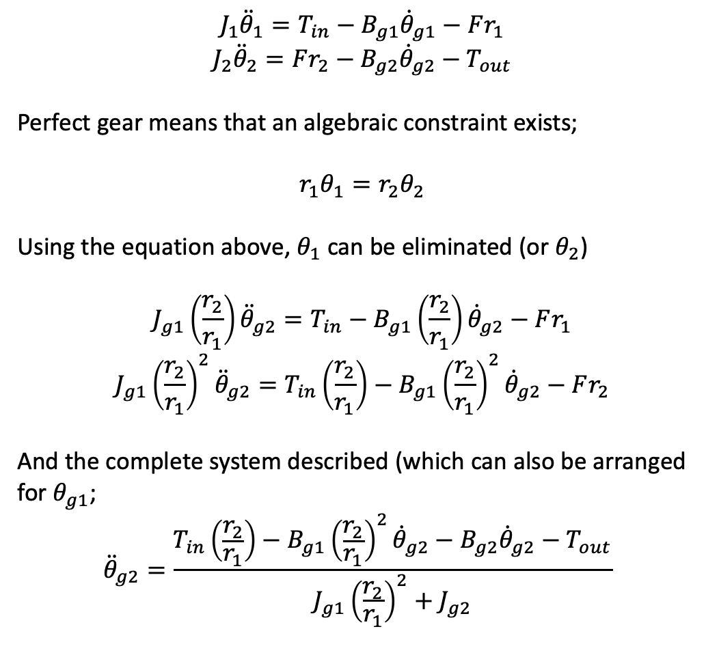


Transmission
$$J_{1}{\ddot{θ}}_{1}=T_{in}−B_{g1}{\dot{θ}}_{g1}−Fr_{1}$$
$$J_{2}{\ddot{θ}}_{2}=Fr_{2}−B_{g2}{\dot{θ}}_{g2}−T_{out}$$
Perfect gear means that an algebraic constraint exists;
$$r_{1}θ_{1}=r_{2}θ_{2}$$
Using the equation above, $θ_{1}$ can be eliminated (or $θ_{2}$)
$$J_{g1}\left(\frac{r_{2}}{r_{1}}\right){\ddot{θ}}_{g2}=T_{in}−B_{g1}\left(\frac{r_{2}}{r_{1}}\right){\dot{θ}}_{g2}−Fr_{1}$$
$$J_{g1}{\left(\frac{r_{2}}{r_{1}}\right)}^{2}{\ddot{θ}}_{g2}=T_{in}\left(\frac{r_{2}}{r_{1}}\right)−B_{g1}{\left(\frac{r_{2}}{r_{1}}\right)}^{2}{\dot{θ}}_{g2}−Fr_{2}$$
And the complete system described (which can also be arranged for $θ_{g1}$;
$${\ddot{θ}}_{g2}=\frac{T_{in}\left(\frac{r_{2}}{r_{1}}\right)−B_{g1}{\left(\frac{r_{2}}{r_{1}}\right)}^{2}{\dot{θ}}_{g2}−B_{g2}{\dot{θ}}_{g2}−T_{out}}{J_{g1}{\left(\frac{r_{2}}{r_{1}}\right)}^{2}+J_{g2}}$$
Subs for ${\dot{θ}}_{g1}=\frac{r_{2}}{r_{1}}{\dot{θ}}_{g2}$
$$×\frac{r_{2}}{r_{1}}$$

Slide 13
Final Drive, Differential and Driveshaft
Driveshaft propagates torsional oscillation through compliance.
Simple to model, less so to parameterise.
System equations

Slide 14
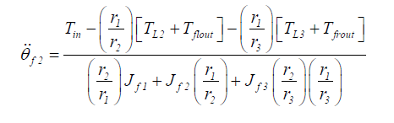
Final Drive, Differential and Driveshaft
Final drive represents final ratio change.
Can include complex non-linearities such as lash, active/passive friction systems.
Simple to implement at most basic level.
The three inertias are represented;
Subject to the constraints;
After some algebraic manipulation, to give;

Slide 15
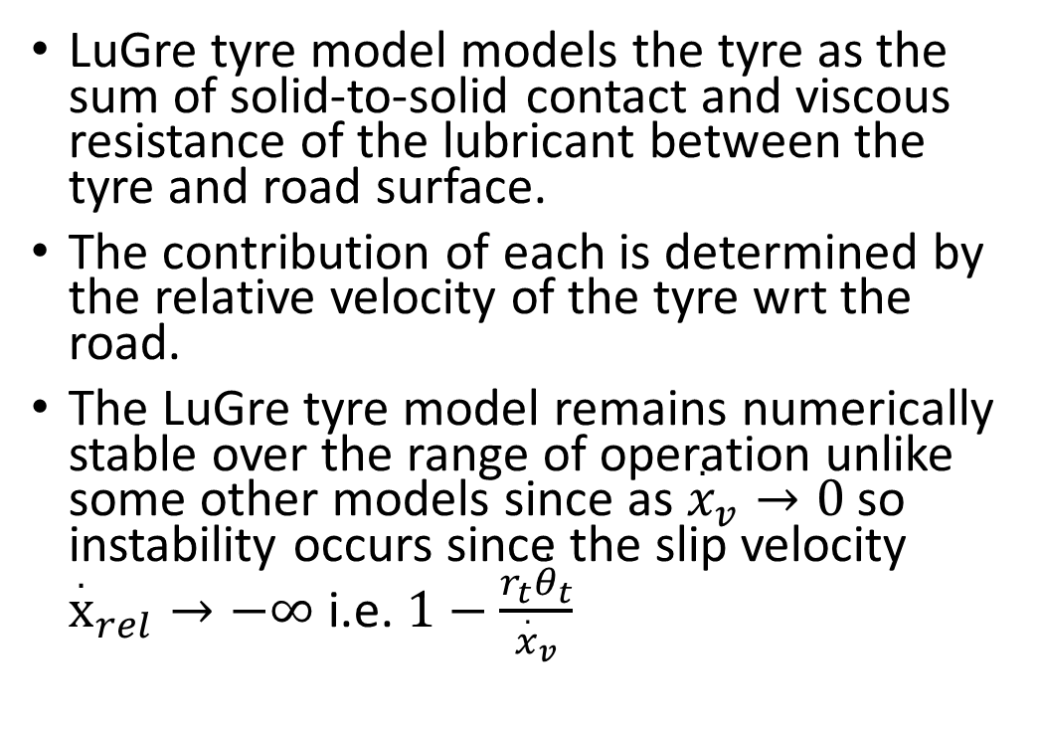
Wheel and Tyres
LuGre tyre model models the tyre as the sum of solid-to-solid contact and viscous resistance of the lubricant between the tyre and road surface.
The contribution of each is determined by the relative velocity of the tyre wrt the road.
The LuGre tyre model remains numerically stable over the range of operation unlike some other models since as ${\overset{.}{x}}_{v}→0$ so instability occurs since the slip velocity ${\overset{.}{x}}_{rel}→−∞$ i.e. $1−\frac{r_{t}{\overset{,}{θ}}_{t}}{{\overset{.}{x}}_{v}}$

Slide 16
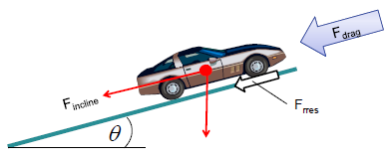
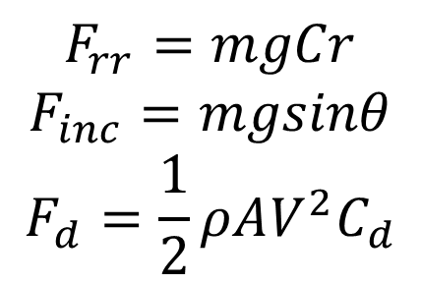

Vehicle Chassis
Force generated in the tyre contact patch is applied to the vehicle chassis.
$$F_{rr}=mgCr$$
$$F_{inc}=mgsinθ$$
$$F_{d}=\frac{1}{2}ρAV^{2}C_{d}$$
$$T=Fr$$

